Slide 1
Paradise
Hotel Management System

Slide 2
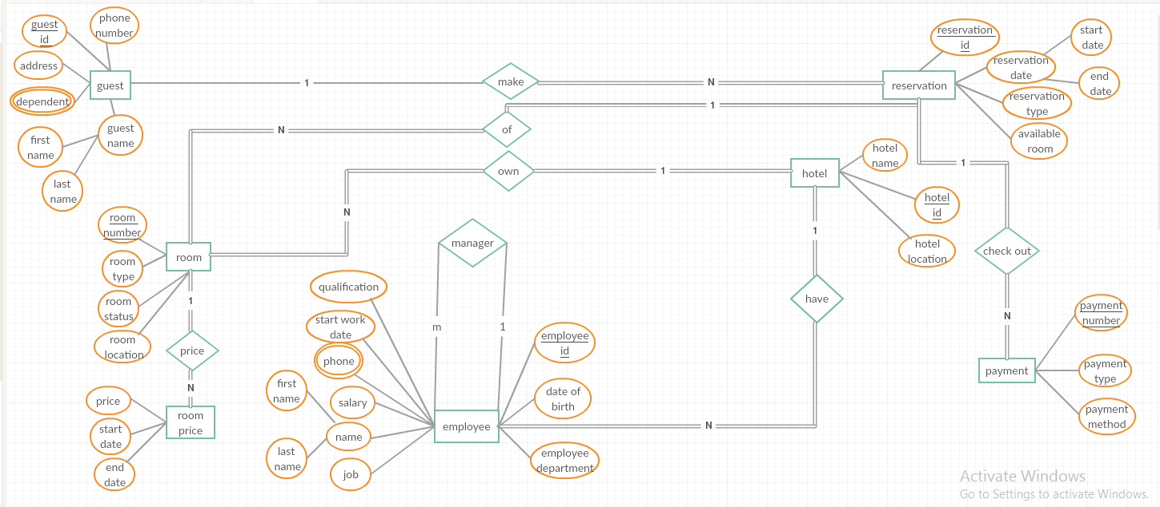
The ERD of Hotel Management System

Slide 3
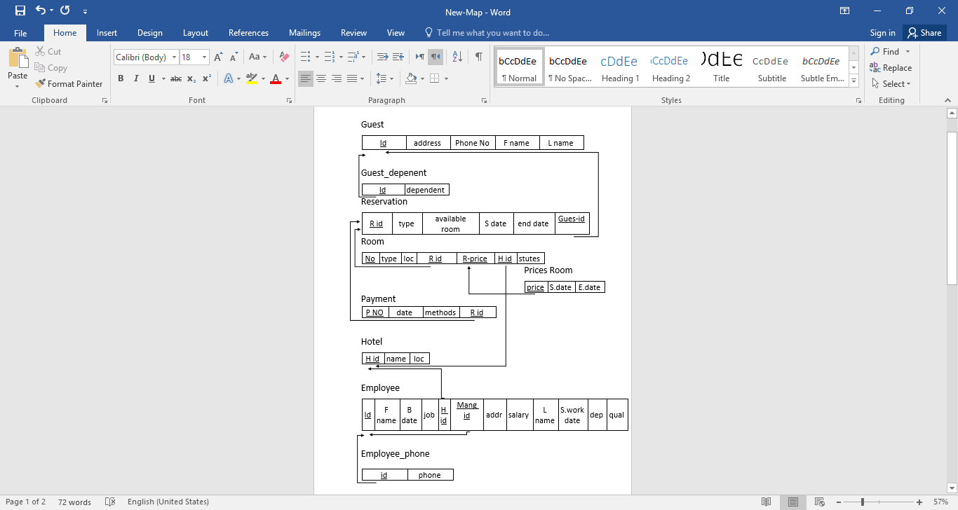
The Mapping of ERD Hotel Management System

Slide 4
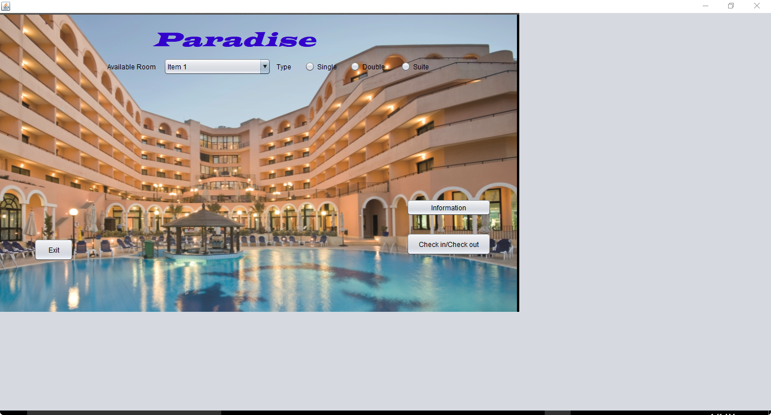
The Home Page Of The Hotel
Where we can:
know the available rooms in the hotel.
Go to do check in or check out.
Know information about employees and reserved rooms.

Slide 5
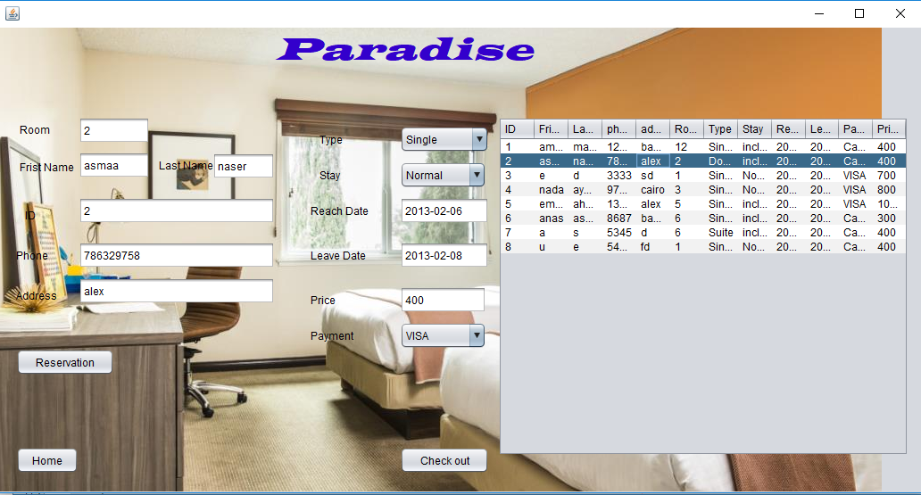
Here we can:
Make check in or check out.
Make reservation.

Slide 6
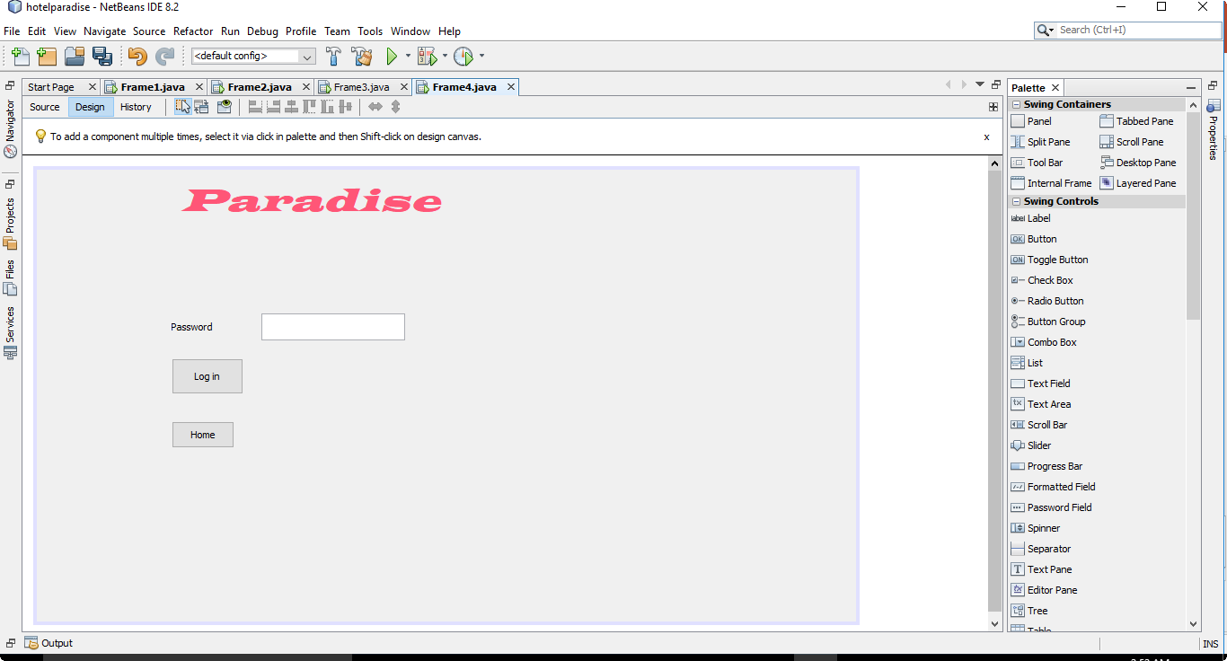
Here:
We should enter the password to go on two forms where there are information about rooms and employees in the two next slides.

Slide 7
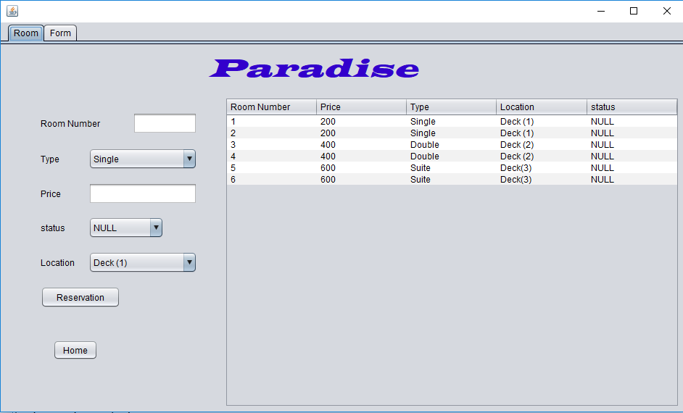
Here we can:
Show Information about reserved rooms (type – price – status - location).
Know the total cost of accommodation.

Slide 8
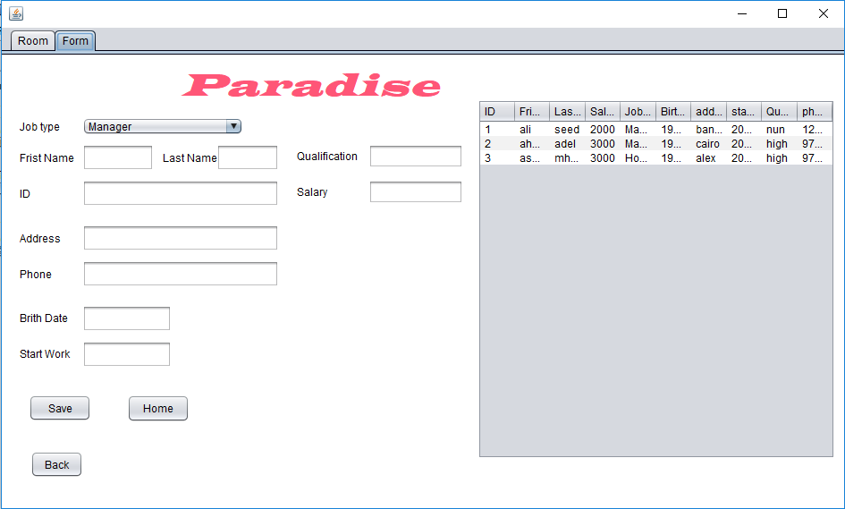
Here we can:
Enter all information about employees who will be employed.

Slide 9
Thank you

